Slide 1
Chapter 00
Introducing Foundations

Slide 2

Direct-Addressing Table[4 – 5] Hash table [6 - 12] Collision Resolutions [13-24] Linear Probing [14] Open Hashing (Chaining) [15 -17] Load Factor [18], Simple Uniform[19], and Performance [20-24] Good Hash functions [25 – 50] Assumptions [26], Key Interpretations [28], Modular Hashing [30, 32], Multiplication Hashing [33, 36], Universal hashing [37-38, 40-41] Open Addressing (Closed Hashing)[51-70] Linear Probing [59 - 61], Quadratic Probing [62], Double Hashing [63 - 66]
Contents

Slide 3
Hash Tables

Slide 4
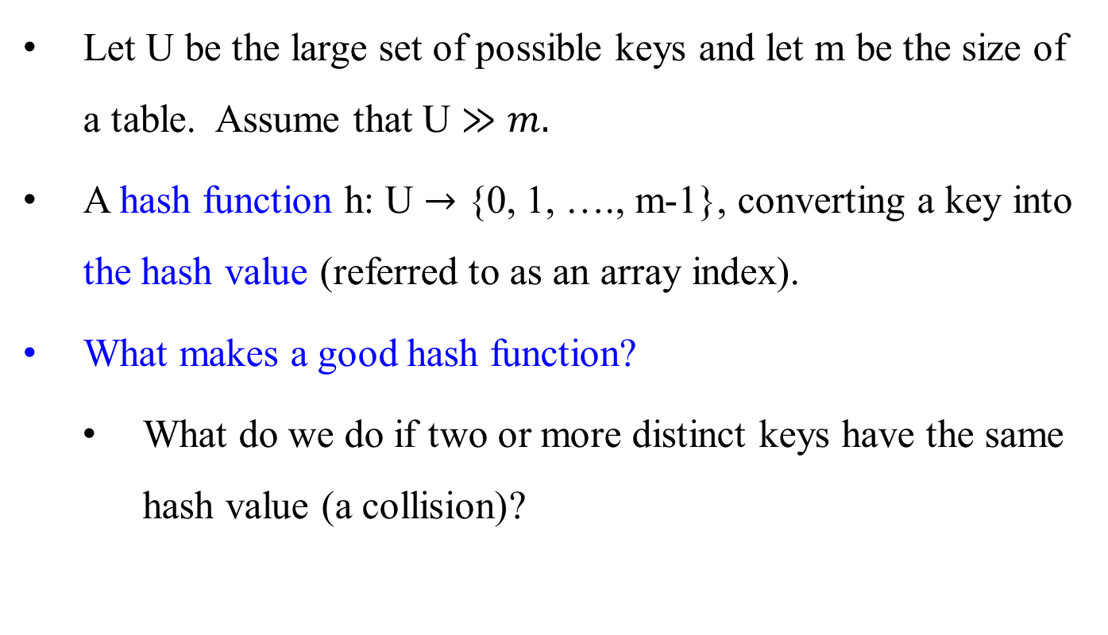
Hash Functions – What makes a good hash function?
Let U be the large set of possible keys and let m be the size of a table. Assume that U $≫m.$
A hash function h: U $→$ {0, 1, …., m-1}, converting a key into the hash value (referred to as an array index).
What makes a good hash function?
What do we do if two or more distinct keys have the same hash value (a collision)?

Slide 5

Hash Function – What makes a good hash function?
A good hash function
is easy to compute and has minimal collisions.
satisfies (approximately) the assumption of simple uniform hashing:
each key is equally likely to hash to any of the m slots, independently of where any other key has hashed to.
For a random key, the probability of each hash value would be equally likely.
Assure keys with their records are distributed evenly throughout the hash table

Slide 6
Hash Functions – What makes a good hash function?
Interpreting keys as natural numbers
Assume that the universe of keys is the set N = {0, 1, 2, …} of natural numbers.
Find a way to interpret keys as large natural numbers, if they are not natural numbers. Then, compute the hash value.
Example:
If a key is a character string, then interpret it as an integer expressed in suitable radix notation.
Let interpret pt as the pair of decimal integers (112, 116), according to the ASCII character set. Then, expressed as a radix –128 integer, pt becomes
(112*128) + 116 = 14452, where 128 is 2⁷.
opt can be computed (((111*128) + 112)*128) + 116 = 1833076, using Horner Rule.
nopt can be computed (((((110*128) + 111)*128) + 112)*128) + 116 = …

Slide 7

Example of Hash for Character Strings:
If K is a character string c₀ c₁ … c_{n-1}, then, as an unsophisticated option, use
h(K) = ($\sum_{i=0}^{n−1}{ord(c_{i}))}$ mod m,
where m is a given table size, and $ord\left(c_{i}\right) is the ordinal value ofc_{i}.$
For a long character string K, a better option is to compute h(K) by using Horner’s rule to calculate the result piecewise:
h ← 0;
for (i ← 0 to n – 1) do {
h ← (h * C + ord(c_{i}))mod m; }
where C is a constant larger than every ord(c_{i}). e.g., C can be 128 if ASCII codes are used. As an example, when i = 2, h(c₀c₁c₂ ) is
((ord(c₀)mod m * C + ord(c₁))mod m * C + ord(c₂))mod m

Slide 8
Hash Functions – What makes a good hash function?
Modular Hashing – the Division Method for creating hash functions:
The modular hashing method is:
The hash function is h(k) = k mod m.
Map a key k into one of the m slots by taking the remainder of k divided by m.
Good values for m are primes not too close to exact powers of 2
Choosing m to be closer to a power of two, 2^{p}, could cause problems.
If m = 2^{p}, h(k) is the p number of lowest-order bits of k. High frequency of collision occurrences.
An example:
Let m = 2⁴ (10000). If k =13 (1101), 29 (11101), 45 (101101), 61 (111101) …. then they have the same hash value h(k) = k (mod m) = 1101₂ which is just the 4 lowest-order bits of k.
In comparison with m = 13, then their hash value h(k) would be 0000, 0011, 1011, 1001, … respectively.

Slide 9
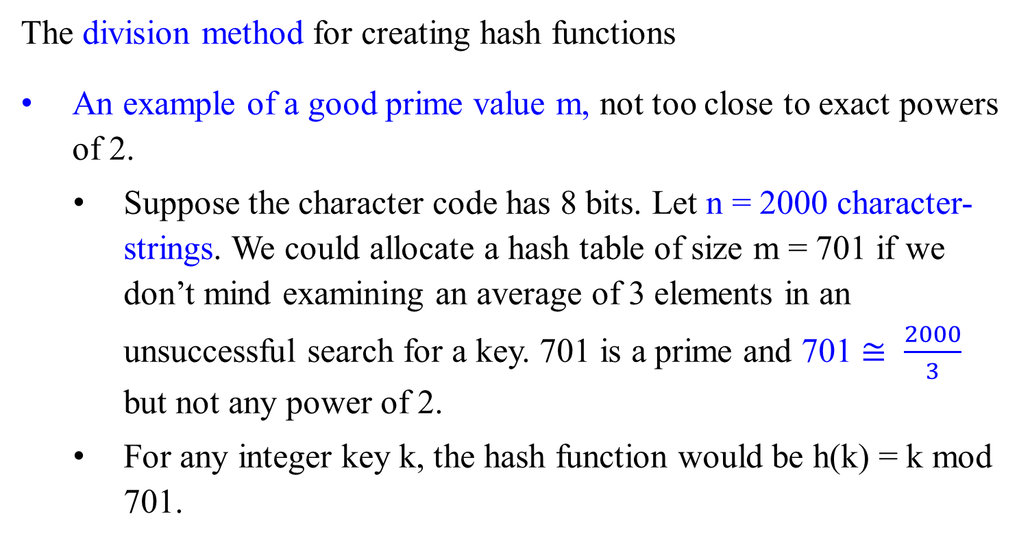
Hash Functions – What makes a good hash function?
The division method for creating hash functions
An example of a good prime value m, not too close to exact powers of 2.
Suppose the character code has 8 bits. Let n = 2000 character-strings. We could allocate a hash table of size m = 701 if we don’t mind examining an average of 3 elements in an unsuccessful search for a key. 701 is a prime and 701 $≅ \frac{2000}{3}$ but not any power of 2.
For any integer key k, the hash function would be h(k) = k mod 701.

Slide 10


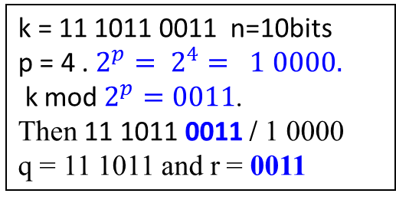
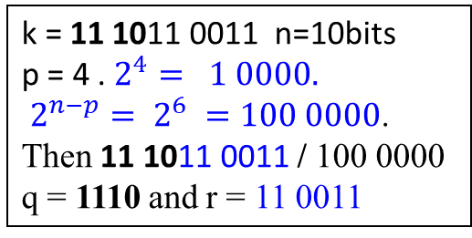
Hash Functions – What makes a good hash function?
The significant bits for creating hash functions
Two obvious hash functions: either the first (most significant) or last (least significant) p bits of the key k.
Assume that the table size is $2^{p}$. (i.e., m = $2^{p}$) --- for ease of implementing the h(k) function
Let k be an n-bit integer.
Compute these hash functions as follows:
The hash function h(k) = └ $\frac{k}{2^{n−p}}$ ┘
the hash value of the first p bits of k. (quotient).
The hash function h(k) = k mod $2^{p}$
the hash value of the last p bits of k. (remainder).
Time for computing these hash functions is fast.
They are bad hash functions, especially for strings.
k = 11 1011 0011 n=10bits
p = 4 . $2^{4}= 1 0000.$
$2^{n−p}= 2^{6} =100 0000$.
Then 11 1011 0011 / 100 0000
q = 1110 and r = 11 0011
k = 11 1011 0011 n=10bits
p = 4 . $2^{p}= 2^{4}= 1 0000.$
k mod $2^{p}=0011$.
Then 11 1011 0011 / 1 0000
q = 11 1011 and r = 0011
e.g., h(xbcde) = h(ybcde) = h(zbcde)

Slide 11
Hash Functions – What makes a good hash function?
Consider the bits in middle for improving the significant bits method.
The Multiplication method for creating hash functions
This method involves two steps:
Multiply the key k by a constant A in the range 0 < A < 1 and extract the fractional part of kA via (kA –└ k A ┘). ---(3210*0.62 –└ 3210*0.62 ┘) = 0.2
1990.20 – 1990 = 0.2
Compute └ m(kA –└ k A ┘) ┘. --- └ m(kA –└ k A ┘) ┘= └ 128*0.2 ┘= └ 25.6 ┘ = 25
Then the hash function is h(k) = └ m(kA –└ k A ┘) ┘ = └ m(k A mod 1) ┘
where “k A mod 1” means the fractional part of k A,
i.e., k A mod 1 = kA – 1*└ k A ┘ = kA –└ k A ┘.
--- └ m(k A mod 1) ┘ = └ 128(3210*0.62 mod 1) ┘ = └ 128(1990.20 mod 1) ┘ = 128*0.20 = 25
If A = 1/ 2^{n} and m = 2^{p}, it is easy to compute h(k) is bits n thru n + p.
Let K be a value of k > n bits. Let A =1/ 2^{n}. k*A yields the rightmost n bits of k. Multiply m(k*A) would be 2^{p} * (n-bits product, says > 2^{n}) yields 2^{p+n}

Slide 12

Hash Functions – What makes a good hash function?
The Multiplication method for creating hash functions
That the value of m is not critical is an advantage of the multiplication method.
Choose m = 2^{p} for some integer p.
Suppose that the machine’s word size is w bits and a key k fits into a single word, the w-bit representation of the key k.
Restrict A to be a fraction of the form s / 2^{w} where s is an integer
in the range 0 < s < 2^{w}. i.e., s = └ A * 2^{w} ┘.
First multiply k by the w-bit integer └ A * 2^{w} ┘, 0 < A < 1
The result is a 2w-bit value r₁ 2^{w} + r₀, where
r₁ is the high-order word of the product and
r₀ is the low-order word of the product.
The desired p-bit hash value consists of
the p most significant bits of r₀.
w bits
k
*(multiply)
└ A * 2^{w} ┘
r₁
r₀
extract p bits
Fig: The multiplication method of hashing.
h(k)
h(k) = └ $\frac{k}{2^{n−p}}$ ┘ where k = r₀, n = 32,

Slide 13
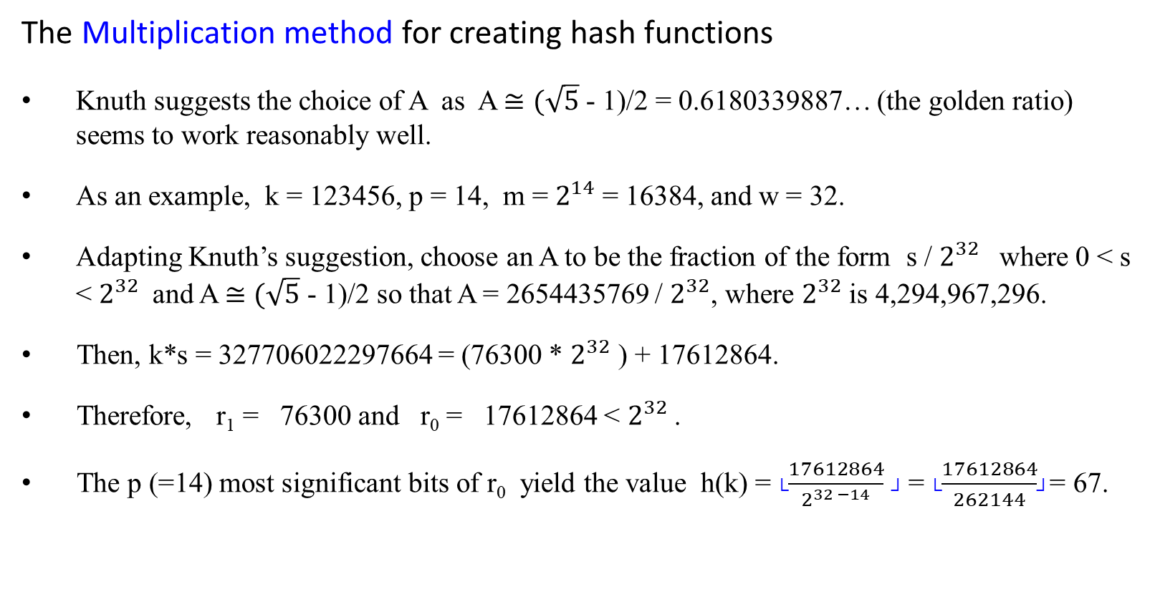
Hash Functions – What makes a good hash function?
The Multiplication method for creating hash functions
Knuth suggests the choice of A as A $≅(\sqrt{5}$ - 1)/2 = 0.6180339887… (the golden ratio) seems to work reasonably well.
As an example, k = 123456, p = 14, m = $2^{14}$ = 16384, and w = 32.
Adapting Knuth’s suggestion, choose an A to be the fraction of the form s / $2^{32}$ where 0 < s < $2^{32}$ and A $≅(\sqrt{5}$ - 1)/2 so that A = 2654435769 / $2^{32}$, where $2^{32}$ is 4,294,967,296.
Then, k*s = 327706022297664 = (76300 * $2^{32}$ ) + 17612864.
Therefore, r₁ = 76300 and r₀ = 17612864 < $2^{32}$.
The p (=14) most significant bits of r₀ yield the value h(k) = └$\frac{17612864}{2^{32 −14}}$ ┘ = └$\frac{17612864}{262144}$┘= 67.

Slide 14

Hash Functions – What makes a good hash function?
The Multiplication method for creating hash functions
Knuth suggests the choice of A as A $≅(\sqrt{5}$ - 1)/2 = 0.6180339887… (the golden ratio) seems to work reasonably well.
Example: k = 123456, m = 10000 < $2^{14}$ , and A = 0.6180339887…, then
h(k) = └ m(k A mod 1) ┘
= └ 10000(123456 * 0.61803… mod 1) ┘
= └ 10000(76300.0041151… mod 1) ┘
= └ 10000 (0.0041151…) ┘
= └ 41.151 ┘
= 41.
If m = 2¹⁴ , then h(k) = 67

Slide 15
Hash Functions – What makes a good hash function?
Universal hashing
An ideal hash function?
For any hash function h there exists a “bad set of keys”, which says n keys, chosen by the malicious adversary, that all hash to the same slot, yielding an average retrieval time of ϴ(n).
The solution is to choose a hash function randomly from a family of hash functions, instead of using a fixed hash function.

Slide 16
Hash Functions – What makes a good hash function?
Universal hashing
An ideal hash function?
The universal hashing approach is to choose the hash function randomly in a way that is independent of the keys that are actually going to be stored.
The main idea behind universal hashing is to select the hash function at random at run time from a carefully designed class of functions.
The probability of a collision between any two keys is provably 1/m, where m is the size of the table.
Implementing universal hash functions necessarily involves randomization.
The first approach: Select the hash function at random at run time from a carefully designed class of functions (for yielding the desired property).
The second approach: Randomize the hash function itself.

Slide 17
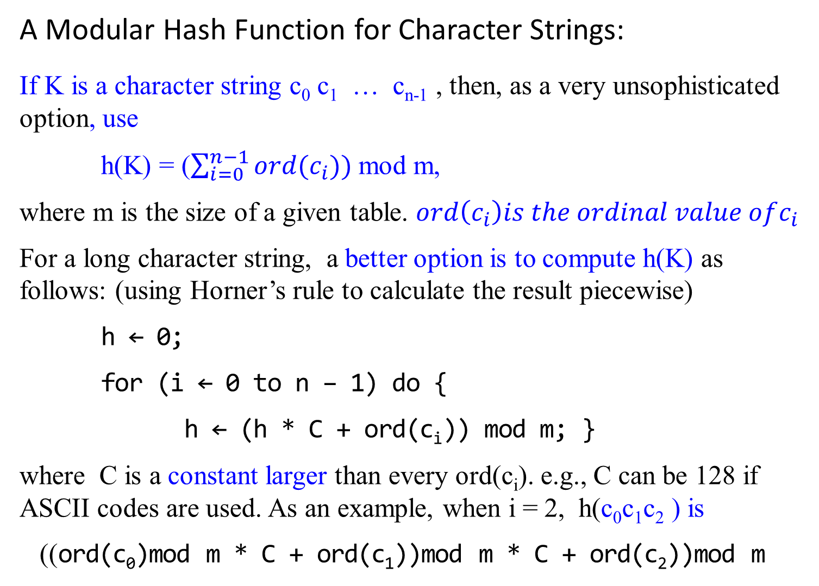
A Modular Hash Function for Character Strings:
If K is a character string c₀ c₁ … c_{n-1} , then, as a very unsophisticated option, use
h(K) = ($\sum_{i=0}^{n−1}{ord(c_{i}))}$ mod m,
where m is the size of a given table. $ord\left(c_{i}\right)is the ordinal value ofc_{i}$
For a long character string, a better option is to compute h(K) as follows: (using Horner’s rule to calculate the result piecewise)
h ← 0;
for (i ← 0 to n – 1) do {
h ← (h * C + ord(c_{i})) mod m; }
where C is a constant larger than every ord(c_{i}). e.g., C can be 128 if ASCII codes are used. As an example, when i = 2, h(c₀c₁c₂ ) is
((ord(c₀)mod m * C + ord(c₁))mod m * C + ord(c₂))mod m

Slide 18
Hash Functions – What makes a good hash function?
A Universal Hash Function for Strings
Consider again the modular hash function for strings
A way to randomize this hash function is to randomize the value of constant C.
Use a simple pseudo-random number generator for this purpose.
hash(str, m)
h ← 0; C ← 31415; x ← 27183;
for (i ← 0 to n – 1) do {
h ← (h * C + ord(c_{i})) mod m;
C ← (C+x) mod (m-1)}
if (h < 0) return h + m
else return h;

Slide 19
Hash Functions – What makes a good hash function?
A Universal Hash Function for Strings
Use a simple pseudo-random number generator for this purpose.
hash(str, m)
h ← 0; C ← 31415; x ← 27183;
for (i ← 0 to n – 1) do {
h ← (h * C + ord(c_{i})) mod m;
C ← (C+x) mod (m-1)}
if (h < 0) return h + m
else return h;
This idea can be extended to integers by multiplying each bye by a random coefficient in the same manner.
It can be shown that this method does produce a universal hash function under the assumption that the coefficients are truly random (not fixed).

Slide 20
Hash Functions – What makes a good hash function?
A Universal Hash Function for Integers
Let p be a large prime number such that every k key value is between 0 and p -1.
Let a and b be integers smaller than p with a positive and be nonnegative.
If a and b are selected randomly, then the hash function
H_{a.b} (k) = ((( ak + b) mod p)mod m)
is universal.

Slide 21
Collision Resolution
open hashing (also called separate chaining, or chaining) and
closed hashing (also called open addressing).

Slide 22
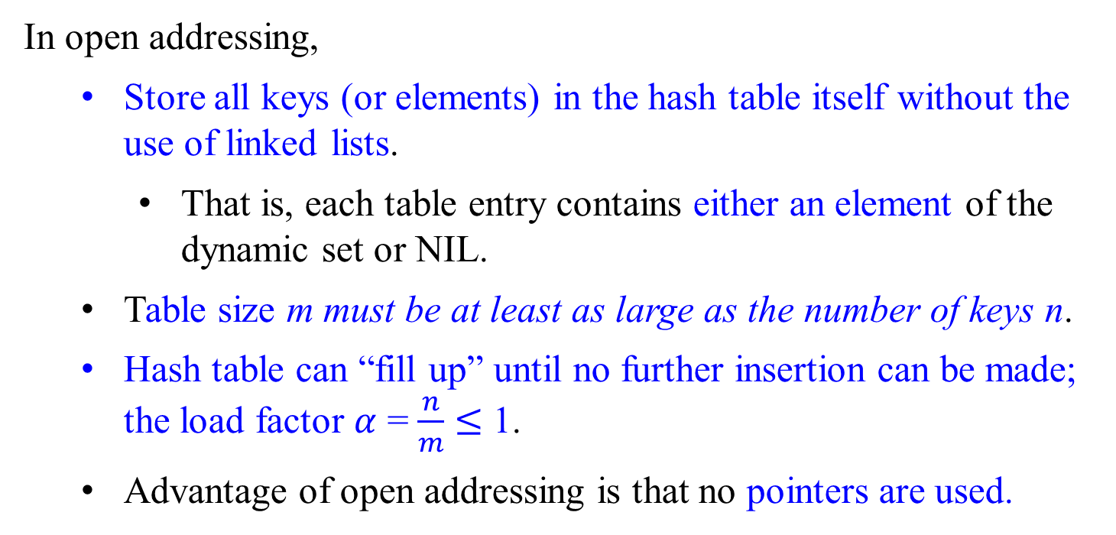
Open Addressing (Closed Hashing)
In open addressing,
Store all keys (or elements) in the hash table itself without the use of linked lists.
That is, each table entry contains either an element of the dynamic set or NIL.
Table size m must be at least as large as the number of keys n.
Hash table can “fill up” until no further insertion can be made; the load factor $α$ = $\frac{n}{m}$ $≤$ 1.
Advantage of open addressing is that no pointers are used.

Slide 23
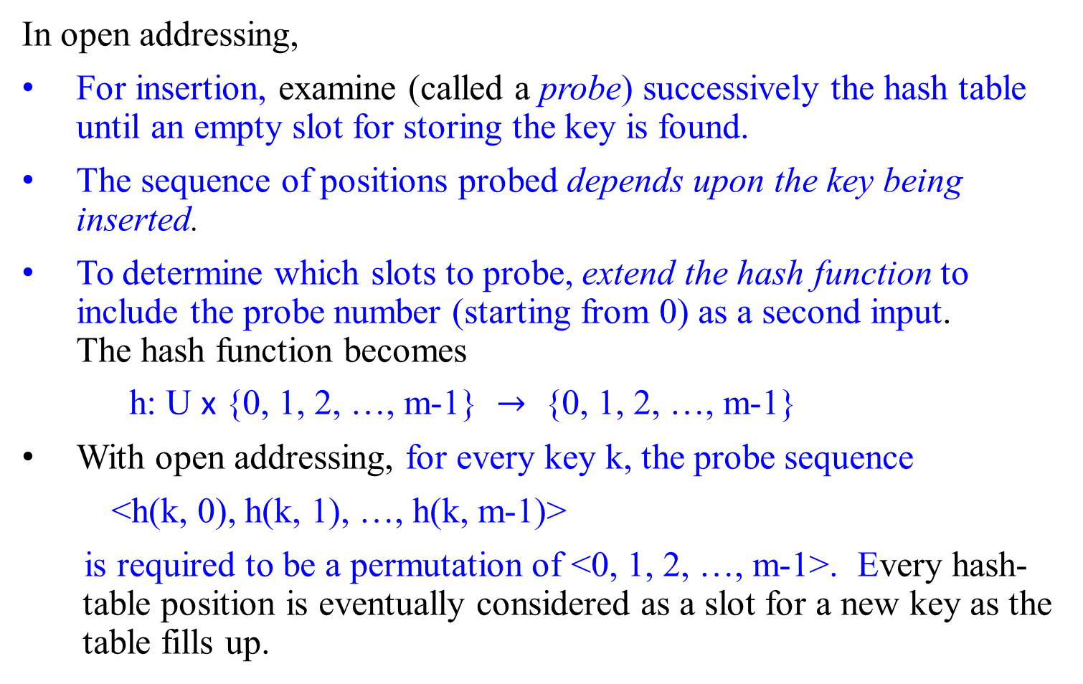
Open Addressing (Closed Hashing)
In open addressing,
For insertion, examine (called a probe) successively the hash table until an empty slot for storing the key is found.
The sequence of positions probed depends upon the key being inserted.
To determine which slots to probe, extend the hash function to include the probe number (starting from 0) as a second input. The hash function becomes
h: U x {0, 1, 2, …, m-1} $→$ {0, 1, 2, …, m-1}
With open addressing, for every key k, the probe sequence
<h(k, 0), h(k, 1), …, h(k, m-1)>
is required to be a permutation of <0, 1, 2, …, m-1>. Every hash-table position is eventually considered as a slot for a new key as the table fills up.

Slide 24

Open Addressing (Closed Hashing)
Assume that the elements in the hash table T are keys with no satellite information; the key k is identical to the element containing key k. Each slot contains either a key or NIL (if the slot is empty). Let h: U x {0, 1, 2, …, m-1} $→$ {0, 1, 2, …, m-1}.
Hash-Insert(T, k)
i $←$ 0
repeat j $←$h(k, i)
if (T[j] == NIL) //or NIL || DELETED if deletion is included
then {T[j] $←$ k
return j; }
else i++;
until i = m;
error “hash table overflow”

Slide 25

Open Addressing (Closed Hashing)
The procedure Hash-Search takes as input a hash table T and a key k, returning j if slot j is found to contain key k, or NIL if key k is not present in table T. Let h: U x {0, 1, 2, …, m-1} $→$ {0, 1, 2, …, m-1}.
Hash-Search(T, k)
i $←$ 0
repeat j $←$h(k, i)
if (T[j] == k)
then return j;
i++;
until T[j] == NIL or i == m; //use NIL || DELETED
return NIL

Slide 26
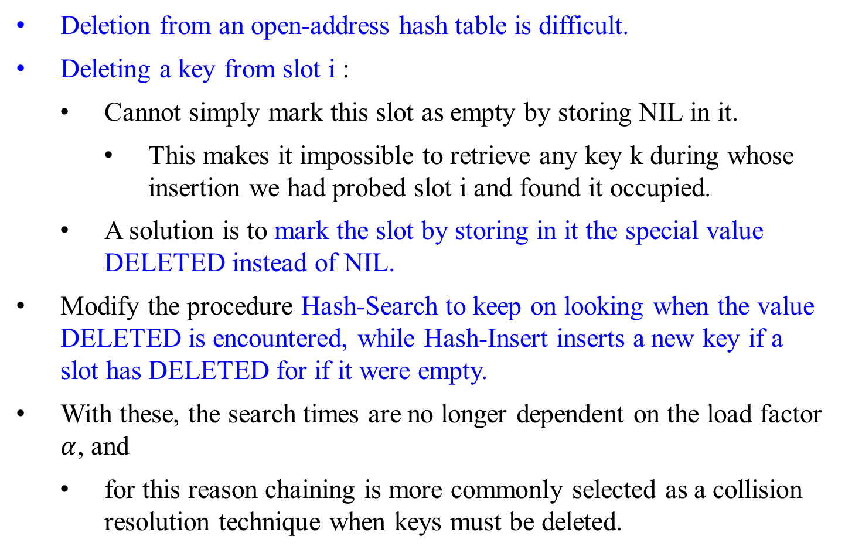
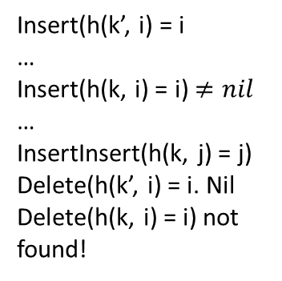
Open Addressing (Closed Hashing)
Deletion from an open-address hash table is difficult.
Deleting a key from slot i :
Cannot simply mark this slot as empty by storing NIL in it.
This makes it impossible to retrieve any key k during whose insertion we had probed slot i and found it occupied.
A solution is to mark the slot by storing in it the special value DELETED instead of NIL.
Modify the procedure Hash-Search to keep on looking when the value DELETED is encountered, while Hash-Insert inserts a new key if a slot has DELETED for if it were empty.
With these, the search times are no longer dependent on the load factor $α$, and
for this reason chaining is more commonly selected as a collision resolution technique when keys must be deleted.
Insert(h(k’, i) = i
…
Insert(h(k, i) = i) $≠nil$
…
InsertInsert(h(k, j) = j)
Delete(h(k’, i) = i. Nil
Delete(h(k, i) = i) not found!

Slide 27
Open Addressing (Closed Hashing)
Three commonly used techniques for computing the probe sequences required for open addressing:
linear probing,
quadratic probing, and
double hashing.
These techniques guarantee that the probe sequence <h(k, 0), h(k, 1), …, h(k, m-1)> is a permutation of <0, 1, 2, …, m-1> for each key k.
None of them fulfills the assumption of uniform hashing, since none of them is capable of generating more than m² different probe sequences (instead of the m!) that uniform hashing requires.
Double hashing has the greatest number of probe sequences and seems to give the best results.

Slide 28
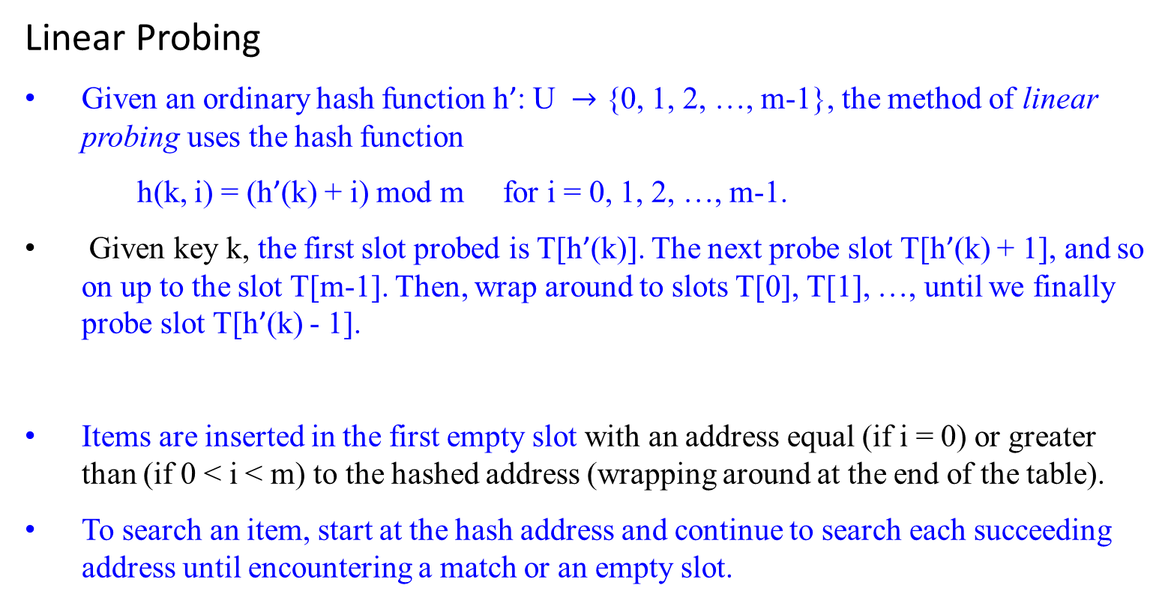
Open Addressing (Closed Hashing)
Linear Probing
Given an ordinary hash function h’: U $→$ {0, 1, 2, …, m-1}, the method of linear probing uses the hash function
h(k, i) = (h’(k) + i) mod m for i = 0, 1, 2, …, m-1.
Given key k, the first slot probed is T[h’(k)]. The next probe slot T[h’(k) + 1], and so on up to the slot T[m-1]. Then, wrap around to slots T[0], T[1], …, until we finally probe slot T[h’(k) - 1].
Items are inserted in the first empty slot with an address equal (if i = 0) or greater than (if 0 < i < m) to the hashed address (wrapping around at the end of the table).
To search an item, start at the hash address and continue to search each succeeding address until encountering a match or an empty slot.

Slide 29
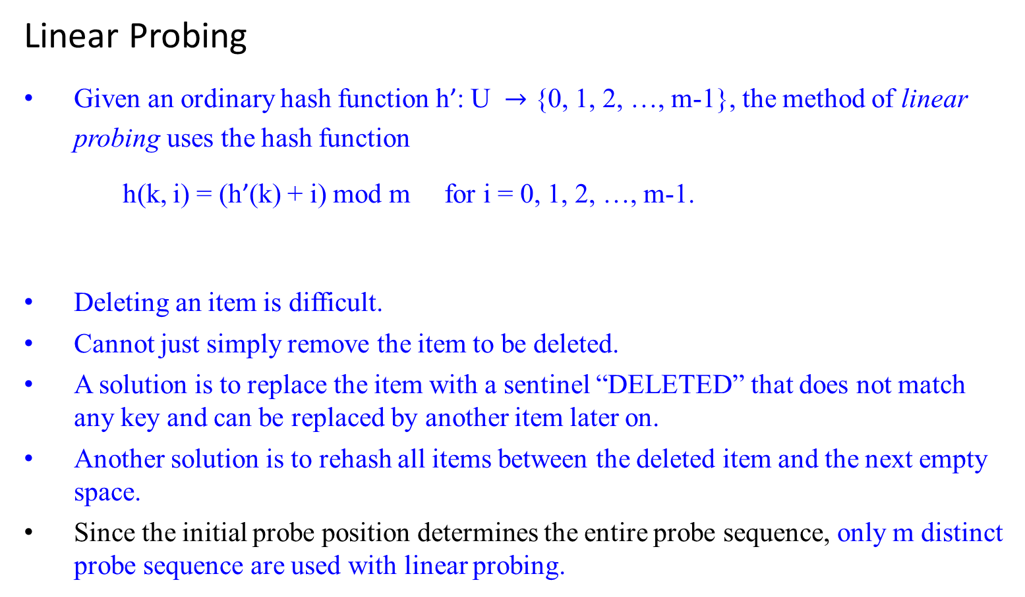
Open Addressing (Closed Hashing)
Linear Probing
Given an ordinary hash function h’: U $→$ {0, 1, 2, …, m-1}, the method of linear probing uses the hash function
h(k, i) = (h’(k) + i) mod m for i = 0, 1, 2, …, m-1.
Deleting an item is difficult.
Cannot just simply remove the item to be deleted.
A solution is to replace the item with a sentinel “DELETED” that does not match any key and can be replaced by another item later on.
Another solution is to rehash all items between the deleted item and the next empty space.
Since the initial probe position determines the entire probe sequence, only m distinct probe sequence are used with linear probing.

Slide 30
Open Addressing (Closed Hashing)
Linear Probing
Linear probing is easy to implement.
It suffers from a problem known as primary clustering.
Long runs of occupied slots build up, increasing the average search time.
If the table has n = m/2 keys, where every even-indexed slot is occupied and every odd-indexed slot is empty, then the average unsuccessful search takes 1.5 probes. (1 + n/m) = (1 + (m/2)/m) = 1 + 0.5 = 1.5
If the first n = m/2 locations are the ones occupied, the average number of probes increases to about n/4 = m/8.
Clusters are likely to arise, since if an empty slot is preceded by i full slots, then the probability that the empty slot is the next one filled is (i+1)/m, compared with a probability of 1/m if the preceding slot was empty.
Thus, runs of occupied slots tend to get longer, and linear probing is not a very good approximation to uniform hashing.

Slide 31

Open Addressing (Closed Hashing)
Quadratic Probing This alleviates the clustering problem by skipping slots.
Uses a hashing function of the form
h(k, i) = (h’(k) + c₁i + c₂i² ) mod m,
where h’ is an auxiliary hash function, c₁ and c₂ $≠$ 0 are auxiliary constants, and 0 $≤$i < m.
The initial position probed is T[h’(k)]; later positions probed are offset by amounts that depend in a quadratic manner on the probe number i.
This method works much better than linear probing, but to make full use of the hash table, the values of c₁, c₂ and m are constrained.
If two keys have the same initial probe position, then their probe sequences are the same, since h(k₁, 0) = h(k₂, 0) implies h(k₁, i) = h(k₂, i). This leads to a milder form of clustering, called secondary clustering.
As in linear probing, the initial probe determines the entire sequence, so only m distinct probe sequences are used.
h’(k) + c₁i + c₂i²
⁼ h’(k’)+c₁i+c₂i²

Slide 32

Open Addressing (Closed Hashing)
Double hashing
Uses a hashing function of the form
h(k, i) = (h₁(k) + i h₂(k) ) mod m,
where h₁ and h₂ are auxiliary hash functions, and 0 $≤$ i < m.
The h₂(k) value must be relatively prime to m for the entire hash table to be searched, i.e., the sequence to include all possible addresses.
Otherwise, if GCD(h₂(k), m) = d > 1 for some key k, then a search for key k would examine (1/d)th of the hash table.
A convenient way to ensure this condition is to let m be a power of 2 and to design h₂ so that it always returns and produces an odd number. Another way is to let m be prime and to design h₂ so that it always returns a positive integer less than m.
Example: choose m prime and let
h₁(k) = k mod m; h₂(k) = 1 + (k mod m’),
where m’ is chosen to be slightly less than m (says, m -1 or m-2).

Slide 33
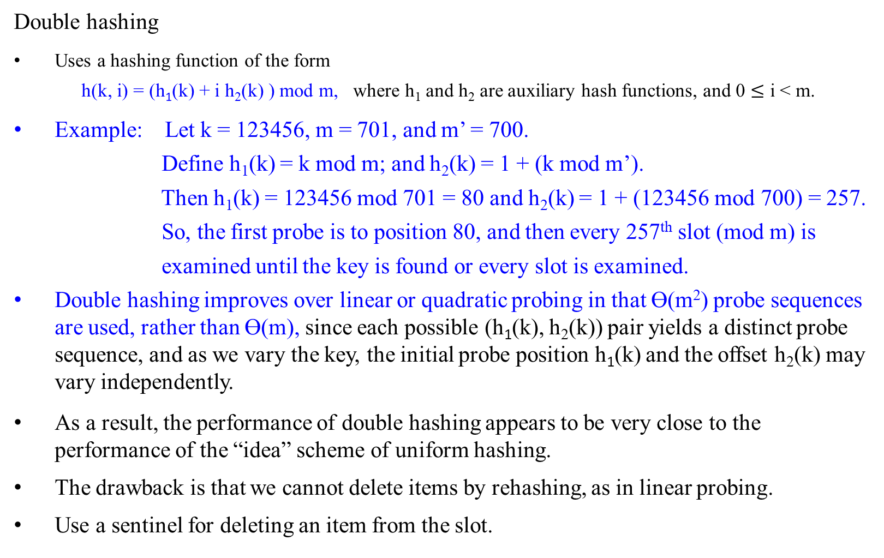
Open Addressing (Closed Hashing)
Double hashing
Uses a hashing function of the form
h(k, i) = (h₁(k) + i h₂(k) ) mod m, where h₁ and h₂ are auxiliary hash functions, and 0 $≤$ i < m.
Example: Let k = 123456, m = 701, and m’ = 700.
Define h₁(k) = k mod m; and h₂(k) = 1 + (k mod m’).
Then h₁(k) = 123456 mod 701 = 80 and h₂(k) = 1 + (123456 mod 700) = 257.
So, the first probe is to position 80, and then every 257th slot (mod m) is
examined until the key is found or every slot is examined.
Double hashing improves over linear or quadratic probing in that ϴ(m²) probe sequences are used, rather than ϴ(m), since each possible (h₁(k), h₂(k)) pair yields a distinct probe sequence, and as we vary the key, the initial probe position h₁(k) and the offset h₂(k) may vary independently.
As a result, the performance of double hashing appears to be very close to the performance of the “idea” scheme of uniform hashing.
The drawback is that we cannot delete items by rehashing, as in linear probing.
Use a sentinel for deleting an item from the slot.

Slide 34
Open Addressing (Closed Hashing)
Double hashing
Uses a hashing function of the form
h(k, i) = (h₁(k) + i h₂(k) ) mod m,
where h₁ and h₂ are auxiliary hash functions.
The initial position probed is T[h₁ (k)]; successive probe positions are offset from previous positions by the amount h₂ (k), modulo m. Thus the probe sequence depends in two ways upon the key k, since the initial probe position, the offset, or both, may vary.
The following figure gives an example of insertion by double hashing.

Slide 35
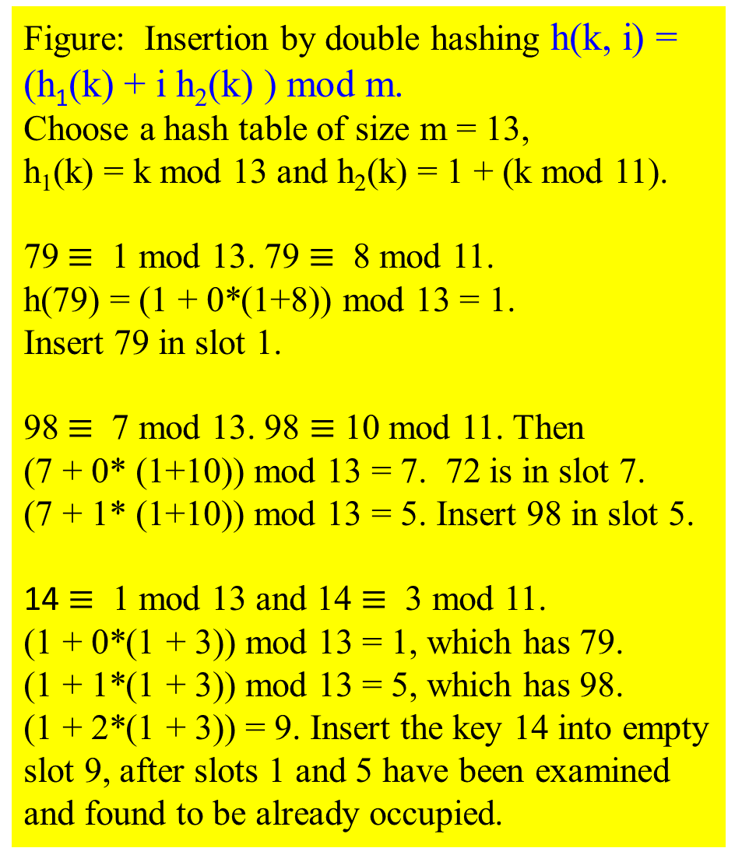
Figure: Insertion by double hashing h(k, i) = (h₁(k) + i h₂(k) ) mod m.
Choose a hash table of size m = 13, h₁(k) = k mod 13 and h₂(k) = 1 + (k mod 11).
79 $≡$ 1 mod 13. 79 $≡$ 8 mod 11.
h(79) = (1 + 0*(1+8)) mod 13 = 1.
Insert 79 in slot 1.
98 $≡$ 7 mod 13. 98 $≡$ 10 mod 11. Then
(7 + 0* (1+10)) mod 13 = 7. 72 is in slot 7.
(7 + 1* (1+10)) mod 13 = 5. Insert 98 in slot 5.
14 $≡$ 1 mod 13 and 14 $≡$ 3 mod 11.
(1 + 0*(1 + 3)) mod 13 = 1, which has 79.
(1 + 1*(1 + 3)) mod 13 = 5, which has 98.
(1 + 2*(1 + 3)) = 9. Insert the key 14 into empty slot 9, after slots 1 and 5 have been examined and found to be already occupied.
0
1 | 79
2
3
4 | 69
5 | 98
6
7 | 72
8
9 | 14
10
11 | 50
12

Slide 36
End of Chapter 0
☺

